Slide 1
Module 1

Slide 2
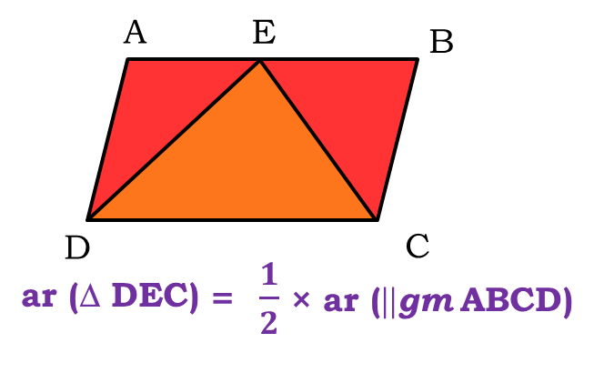
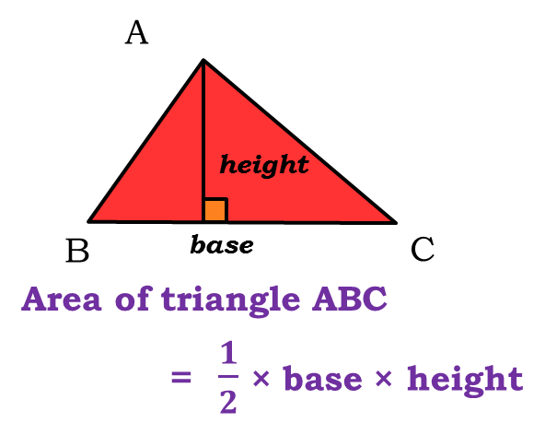
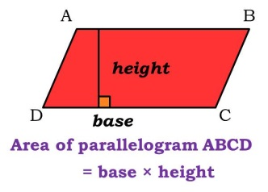
AREAS OF PARALLELOGRAMS AND TRIANGLES

Slide 3
Let us consider two
parallelograms on the same base &
between the same parallel lines
⎫
⎫
ar( ||^{gm}ABCD )
l
=
BC
× AD
⎫
⎫
ar( ||^{gm}BEFC )
=
BC
× FG
A
E
D
F
ar( ||^{gm}ABCD) = ar( ||^{gm}BEFC)
What is the formula for
area of a parallelogram ?
Base × height
Let us drop a
perpendicular from F
on line m
Bases are equal
Heights are equal
Let us drop a
perpendicular from A
on line m
What can we say
about L.H.S. ?
BC × FG
ar( ||^{gm}BEFC) =
?
What can we say
about AD & EG ?
ar(||^{gm}ABCD) = ar(||^{gm}BEFC)
AD = EG
m
So, what can we
conclude from this ?
BC
AD
D
G
Perpendicular distances between the
same parallel lines are equal
B
B
C
C
Parallelograms on the same base and between
the same parallels, are equal in area

Slide 4
Module 2

Slide 5
Let us consider a
parallelogram and a triangle on the
same base & between the
same parallels
ar( ||^{gm}ABCD)
=
BC
× AD
l
1
ar(ΔBEC)
=
× BC × EG
2
Let us drop a
perpendicular from A
on line m
What is the formula for
area of a parallelogram ?
A
E
1
D
1
Area of a triangle ?
∴
Base × height
× base × height
ar(ΔBEC)
=
× BC × AD
2
What can we say
about AD & EG ?
2
AD = EG
So, what can we
conclude from this ?
1
Let us drop a
perpendicular from E
on line m
m
∴
ar(ΔBEC)
=
ar( ||^{gm}ABCD)
2
AD
EG
D
G
BC
BC
Perpendicular distances between the
same parallel lines are equal
B
B
C
C
If a parallelogram & a triangle are on the same base
and between the same parallels, then area of the
triangle is half the area of a parallelogram

Slide 6
Module 3

Slide 7
Heights are equal
⎫
⎫
A
1
ar(ΔABD)
=
× BD × AE
Let us consider
a ΔABC
2
Let us consider
a Median of ΔABC
⎫
⎫
1
1
Area of a triangle ?
× base × height
ar(ΔACD)
=
× DC × AE
2
2
For base BD, the
corresponding height
should be from ?
Let us
consider ΔABD
Consider BD as
the base of ΔABD
AD divides ΔABC
into two triangles
Consider DC as
the base of ΔACD
ΔABD
& ΔACD
ar(ΔABD) = ar(ΔACD)
Vertex A
For base DC, the
corresponding height
will be from ?
Vertex A
AE
A line segment joining the
vertex of a Δ to the midpoint
of its opposite side
BD
B
D
C
E
So, what can we
conclude from this ?
So, what can we
say about ar(ΔABD)
& ar(ΔACD) ?
But, what do we
know about
BD & DC ?
BD = DC
bases are equal
ar(ΔABD) = ar(ΔACD)
A median of a triangle divides
it in to two triangles of equal areas
AD is the Median

Slide 8
Module 4

Slide 9
Let us consider two triangles
having the same base & between the same two parallels
⎫
⎫
l
1
ar(ΔABC)
=
× BC × AE
2
⎫
⎫
A
1
D
ar(ΔDBC)
=
× BC × DG
Let us drop a
perpendicular from A
on line m
2
1
m
Let us drop a
perpendicular from D
on line m
1
× base
× height
ar(ΔABC)
=
Area of a triangle ?
ar(ΔDBC)
What can we say
about AE & DC ?
× BC
× DG
Area of a triangle ?
2
E
G
AE = DC
2
So what about
L.H.S.
Bases are equal
Heights are equal
They are equal
R.H.S. are equal
So, what can we
conclude from this ?
B
B
C
C
Perpendicular distances between the
same parallel lines are equal
BC
AE
If two triangles are on the same base (equal base)
& between the same parallels, their areas are equal

Slide 10
Module 5

Slide 11
Q.
In figure, ABCD, DCFE and ABFE are parallelograms.
In figure, ABCD, DCFE and ABFE are parallelograms.
Show that ar (ADE) = ar (BCF).
Show that ar (ADE) = ar (BCF).
Soln.
In parallelogram ABCD,
A
B
AD
=
BC
...(i) [opposite sides of parallelogram are equal]
In parallelogram DCFE,
D
C
DE
=
CF
...(ii) [opposite sides of parallelogram are equal]
In parallelogram ABFE,
F
E
AE
=
BF
...(iii) [opposite sides of parallelogram are equal]
In Δ ADE and Δ BCF,
Triangles are
congruent means they
have same area
AE and BF are the opposite sides of a parallelogram ABFE
AD and BC are the opposite sides of parallelogram ABCD
AD
=
BC
[From(i)]
DE and CF are the opposite sides of a parallelogram DCFE
DE
=
CF
[From(ii)]
AE
=
BF
[From(iii)]
What do we know about the opposite sides of a parallelogram ?
What do we know about the opposite sides of a parallelogram ?
∴
By SSS criterion of congruence
What do we know about the opposite sides of a parallelogram ?
They are equal
They are equal
ΔADE ≅ ΔBCF
They are equal
∴
ar(Δ ADE) = ar(Δ BCF)

Slide 12
Module 6

Slide 13
Q. Which of the following figures lie on the same base and
between the same parallels. In such a case, write the
common base and the two parallels.
Q. Which of the following figures lie on the same base and
between the same parallels. In such a case, write the
common base and the two parallels.
A
P
B
Sol. (i):-
The two figures have a common base DC
and lie between two parallel lines AB and DC
Does ΔPDC and ABCD lie between two parallel lines ?
Does ΔPDC and ABCD have a common
base ?
Yes, AB and DC
D
C
Sol. (ii):-
Yes, DC
P
Q
The two figures have common base SR and
does not lie between two parallel lines.
Does MSRN and PSRQ have a common
base ?
Yes, SR
M
N
Does MSRN and PSRQ lie between two parallel lines ?
No
S
R

Slide 14
Q. Which of the following figures lie on the same base and
between the same parallels. In such a case, write the
common base and the two parallels.
Q. Which of the following figures lie on the same base and
between the same parallels. In such a case, write the
common base and the two parallels.
P
Q
Sol. (iii):-
The two figures have a common base QR and
lie between two parallel lines PS and QR
T
Does ΔRTQ and RSPQ
lie between two parallel lines ?
Does ΔRTQ and RSPQ have a common
base ?
Yes, PS and QR
S
R
Yes, RQ
A
B
Sol. (iv):-
The two figures lie between two parallel
lines AD and BC, but does not have a
common base.
P
Does ΔPRQ and ABCD have a common base ?
R
No
Does ΔPRQ and ABCD
lie between two parallel lines ?
Yes, BC and AD
Q
D
C

Slide 15
Q. Which of the following figures lie on the same base and
between the same parallels. In such a case, write the
common base and the two parallels.
Q. Which of the following figures lie on the same base and
between the same parallels. In such a case, write the
common base and the two parallels.
A
B
Does ADCP and ADQB have a common base ?
P
Sol. (v):-
Yes, AD
The two figures have common base AD and
lie between two parallel lines AD and BQ.
C
Does ADCP and ADQB lie between two parallel lines ?
Yes, AD and BQ
D
Q
Sol. (vi):-
P
A
B
Q
The two figures lie between two parallel lines PQ
and SR but does not have a common base.
Does DCBA and SRQP have a common base ?
No
Does DCBA and SRQP lie between two parallel lines ?
Yes, PQ and SR
S
D
C
R

Slide 16
Thank You

